Slide 1

Hiking Biomechanics & Ankle Rehabilitation
Next-Generation Systems for Structural Fortification and Trail Readiness

Slide 2
01. Need Recognition
Understanding the biomechanical triggers of ankle injuries on unpredictable terrain.

Slide 3


The Hiking Market Boom & Gap
Global Participation Surge
The Missing Link
Hiking participation has grown massively (2014-2024), driven by physical health benefits, low barrier to entry, and relational wellness. The COVID-19 pandemic further spiked global engagement.
While runners have sophisticated treadmills to replace outdoor running, hikers face unaddressed physical frustrations: wild terrains, unpredictable steps, and high injury rates.
Current solutions (like inclined trainers or aerobic steps) use fixed mechanics and cannot simulate the variable terrain required to bulletproof hikers against the wild.
Despite this massive influx of hikers, the industry is severely lacking in dedicated, hike-specific training equipment.

Slide 4

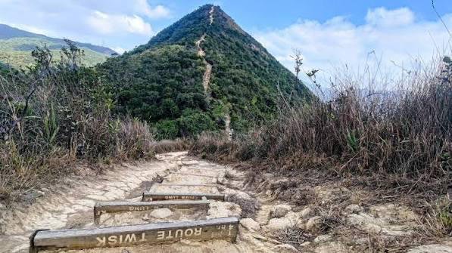
The High-Risk Scenario
The Ankle Twist Nightmare
Descending a trail covered in loose rock or scree carries the greatest risk. Fatigue builds, and the terrain demands constant focus.
The Trigger: A misstep on sliding stone forces the foot into sudden inversion, triggering a lateral sprain.
Biomechanical Danger: Downhill terrain forces the foot into a plantarflexed state, drastically plummeting stability.

Slide 5
The Injury Epidemic
A Growing Crisis in Outdoor Sports
85%
Hiking participation has surged globally, but this growth exposes more people to severe trail-induced injuries. The data highlights a critical need for better prevention.
Acute Lateral Sprains
Lateral ankle sprains account for an overwhelming 85% of acute trail traumas.
49%
In competitive technical races, ankle complex injuries affect nearly half of all participants.
Downhill Race Injury Rate
Even in highly conditioned athletes running ultramarathons, ankle issues remain a massive factor at 21.6%.

Slide 6

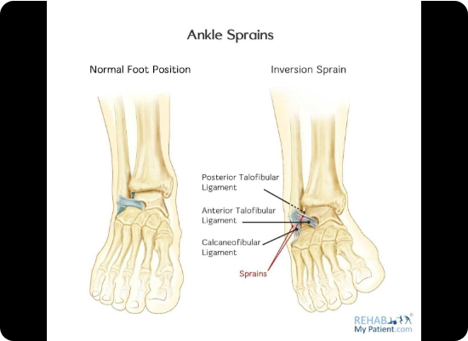
The 25° Threshold
Mechanical Failure Point
An acute injury occurs when a sudden forceful inversion exceeds 25 degrees, tearing the Anterior Talofibular and Calcaneofibular ligaments.
Critical Stabilizers require high-frequency eccentric loading to increase joint stiffness, not just heavy lifting.
Fibularis Group: Longus and Brevis are primarily responsible for eversion and lateral stability.
Tibialis Group: Anterior and Posterior are crucial for dorsiflexion, arch support, and dynamic deceleration.

Slide 7









The Effect of a Time-Loss Injury
Forced Termination
Biomechanical Strain
Chronic Instability
A severe ankle sprain is a definitive time-loss injury. It immediately ends the hiking trip, drastically altering plans and causing psychological frustration for outdoor enthusiasts.
Post-injury, the body compensates. Hikers must rely heavily on their opposite leg, knees, and hips to apply force and balance, leading to secondary overuse strains up the kinetic chain.
Once the 25-degree threshold is breached, the primary ligaments are structurally weakened, leading to chronic joint instability and a much higher likelihood of recurring sprains.

Slide 8
Interview from user
School Team Coach — Hiking, Orienteering & Trail Running
Active Recreational Hiker
Muscle strength alone is not enough for uneven terrain.
Hikers also need balance, core stability, foot placement, centre-of-mass control and rapid reactions.
Uses grass( uneven terrain) , stairs, jumping and single-leg exercises to train different abilities.
Training should progress gradually from stable to unpredictable terrain.
Fatigue must be considered because it can reduce movement control.
Exercises 2–4 times weekly and hikes around once a month.
Has experienced ankle and knee problems despite exercising regularly.
Did not continue prescribed strengthening exercises because they felt repetitive and unnecessary after the pain improved.
Prefers guided, engaging training linked to real elevation profiles, changing slopes and step angles.

Slide 9
The Problem Statement
Hikers navigating unpredictable downhill terrain face a perfect storm for sudden ankle inversion, suffering severe time-loss injuries that prematurely end their expeditions and create long-term chronic instability.
"
"

Slide 10
02. Product Character
Evaluating existing therapies and introducing next-generation biomechanical solutions.

Slide 11


Limitations of Current Therapies
Standard Therapy Tools
Gym Hack Workarounds
Current physical therapy relies heavily on bodyweight and proprioception, lacking structural stress.
Hikers attempt to mimic trails in standard gyms, but results are incomplete and often unsafe.
Dynamic Treadmill Hack: Walking on a flat belt tunes out foot-eye coordination; dropping markers on belts is hazardous.
Resistance Bands & Balance Boards:Excellent for neural reflexes, but cannot safely simulate aggressive rock angles under heavy load.
Box Drop-Landings: Good for isolated downhill impact management, but lacks sustained, variable terrain.
Inflatable Trainers: Great for isolation, but lack the sustained, dynamic weight-bearing momentum of a real descent.
Slacklines: Trains core-to-ankle stability, but provides no continuous eccentric load simulation.

Slide 12

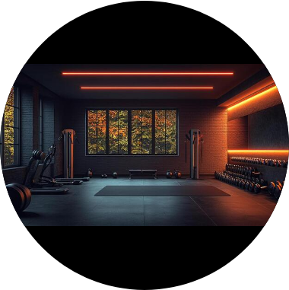
Missing the Mountain
The Synergy Gap
Conventional tools force a compromise: they train either structural strength (traditional gym equipment) or proprioception (stability tools). They fail to safely combine both for a hiker in dynamic motion.
The Structural Gap
"There is currently no existing equipment that can safely simulate the variable step geometry and uneven surface of natural mountain trails under continuous, heavy load.

Slide 13


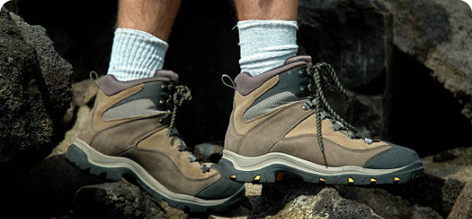
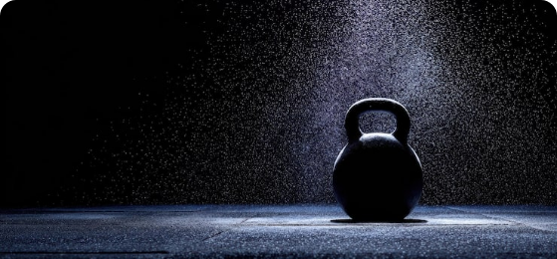
Dual-Pathway Ideation Strategy
1. Practice: Simulation
2. Train: Conditioning
Creating a dynamic environment that mimics real-world trail geometry to train holistic biomechanics, visual anticipation, and complex macro-adjustments.
Developing gym-optimized mechanisms providing variable, high-load eccentric resistance to isolate and bulletproof specific ankle stabilizing muscles.

Slide 14
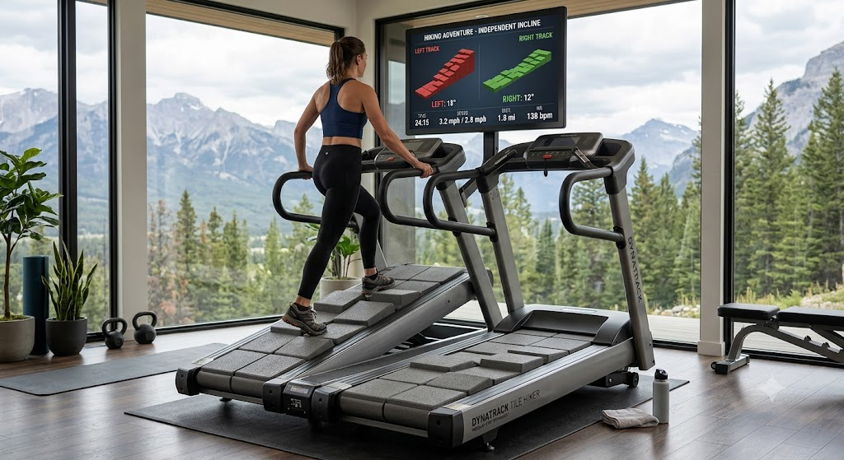
IDEATION 1: Treadmill
Dynamic Hiking Treadmill
Bridging the gap between the gym and the mountains through hyper-realistic terrain simulation.
We are transitioning from standard flat belts to a dual-track, macro-tile architecture. This high-fidelity system perfectly replicates complex outdoor terrains, asymmetrical climbing environments, and the unpredictable nature of trail descents.

Slide 15









Hardware & Software Integration
Hardware Architecture
Software Control
Biomechanical Feedback
Features Dynamic Terrain Tiles (5 modular tiles per side for simulating rocks/stairs) and a Dual Independent Incline Base allowing isolated gradients for lateral slope simulation.
Asymmetric Terrain Profile Integration uses real-world trail data to physically render uneven height adjustments and independent gait control synchronously in real-time.
Bilateral Force Tracking captures specific pressure distributions across the split tracks to instantly identify biomechanical imbalances and muscular asymmetries.

Slide 16
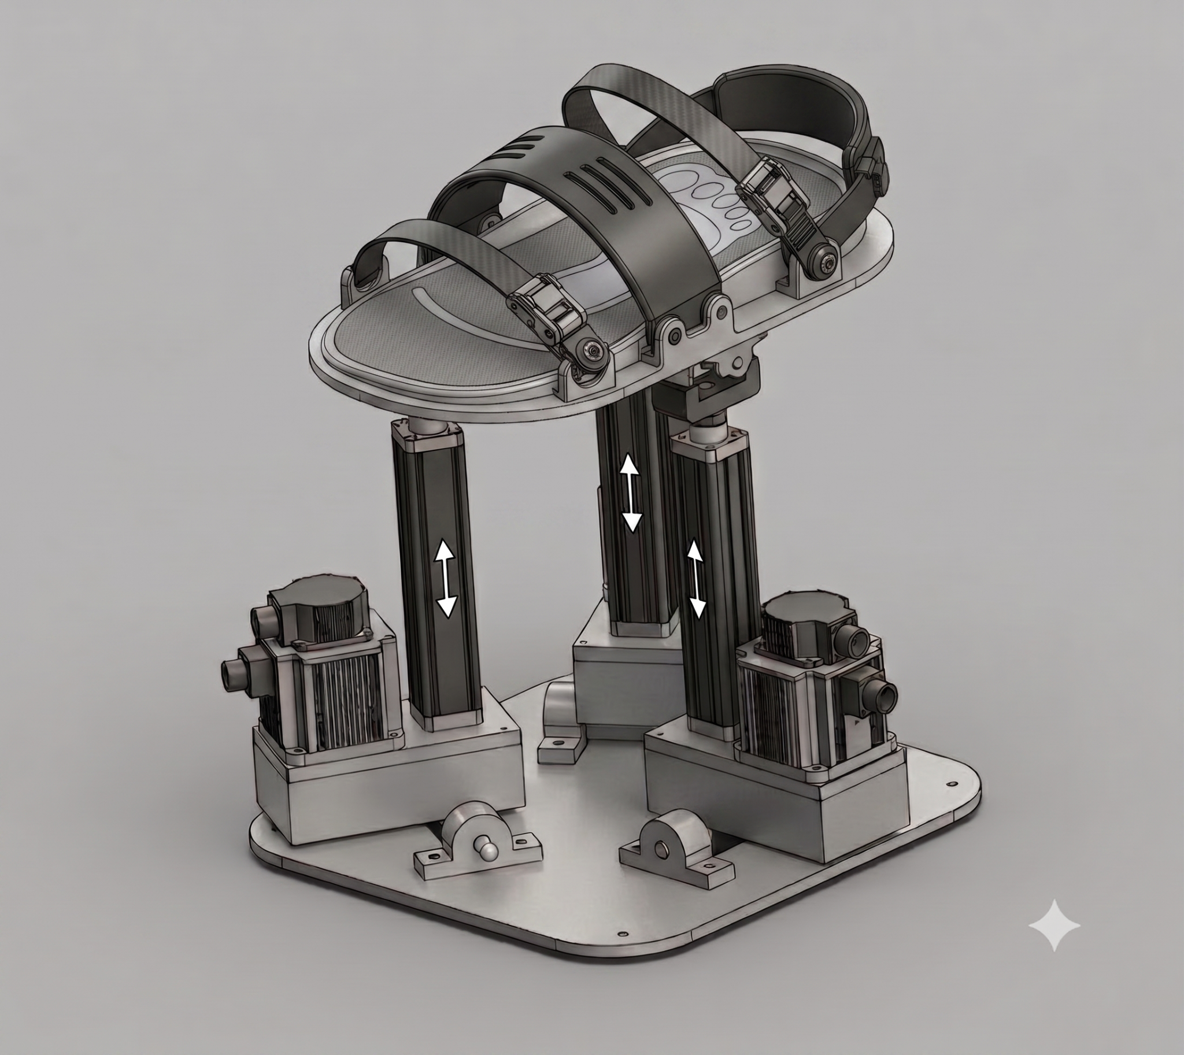
IDEATION 2: Pedal Trainer
Unrelenting Structural Load
Designed to address the exact limitation of bodyweight therapy by adding continuous, heavy resistance for deep structural strengthening.
Active Resistance: Linear motors push or pull the dome pedal to a constant, challenging angle.
Constant Load: The user must exert sustained eccentric force to return the pedal to a neutral position.
Safety Override: If the user fatigues mid-rep, motors slowly retreat to the safe default position to prevent injury.

Slide 17
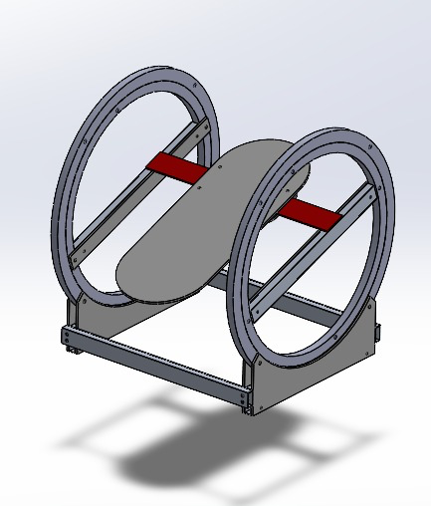
IDEATION 3: Actuation Belt
Neurological Reflex Training
A stationary training device where the user's foot is secured, designed to drastically improve muscle reaction time and defend against sudden inversion.
Central Pedal Interface: Secures the foot completely for targeted isolation.
Multi-Axis Resistance: Applies sudden resistance across Pitch (dorsiflexion), Yaw (rotation), and Roll (inversion) axes.
Dual Control Frameworks: Motorized rotating bars manipulate the belt's angle and tension in real-time, forcing protective muscles to fire instantly.

Slide 18
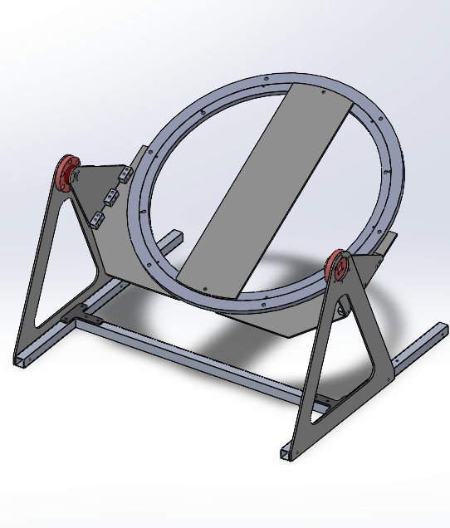
IDEATION 4: Independent Twisting Trainer
Neurological Reflex Training
A stationary training device where the user's foot is secured, designed to drastically improve muscle strength and defend against sudden inversion.
Central Pedal Interface: Secures the foot completely for targeted isolation.
Multi-Axis Resistance: Applies sudden resistance across Pitch (dorsiflexion), Yaw (rotation), and Pitch (tilt) axes.
Dual Control Frameworks: Motorized rotating bars manipulate the angle to give resistance to the users

Slide 19
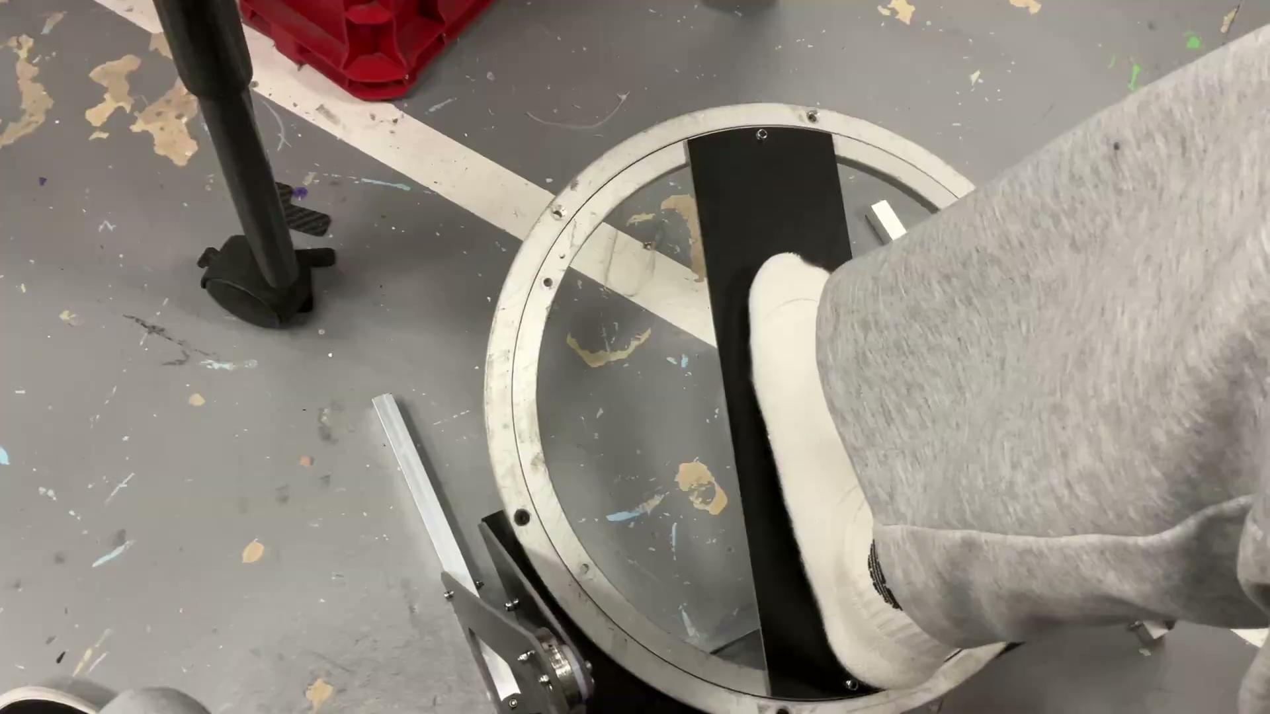
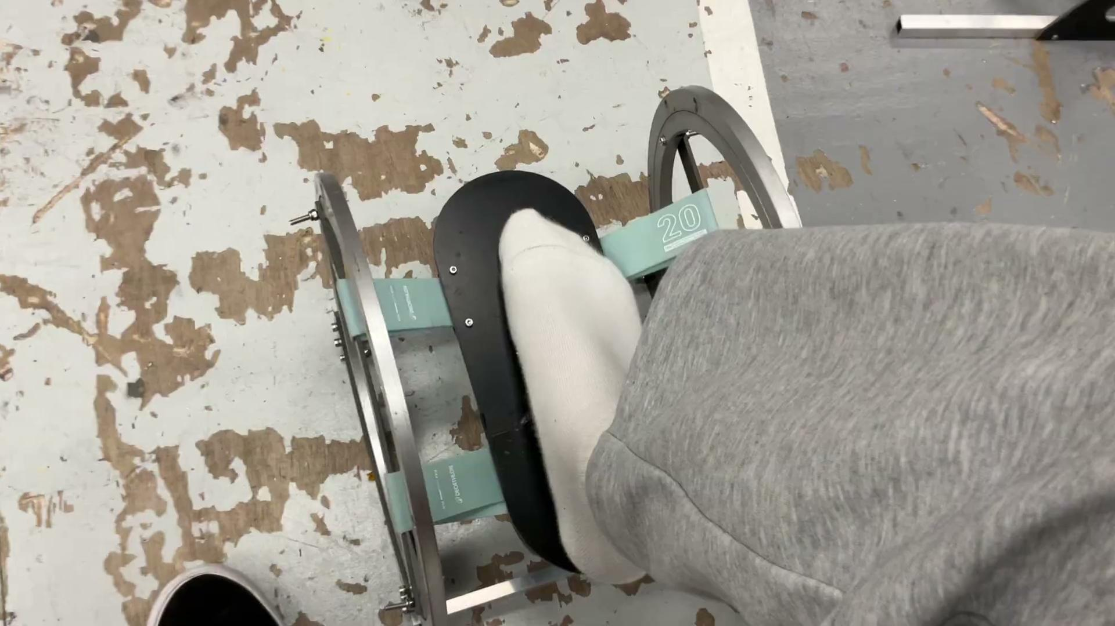
Prototype

Slide 20








System Conclusion
Simulation
Reflex
Strength
Dynamic Treadmill
Actuation Belt
Pedal Trainer
Focuses on real-world environment simulation, forcing complex macro-adjustments to prepare the body for actual trail unpredictability.
Focuses on the neurological connection, sharply reducing reaction times to sudden instability across all three axes of ankle movement.
Focuses on deep structural integrity, utilizing constant motorized load to build the eccentric braking strength needed for safe descents.

Slide 21
DEMO
Interactive System Demonstration

Slide 22
Thank You
Are there any questions regarding the biomechanics or system architecture?

